Slide 1
Project 2 Solution

Slide 2
As with Project 01, this assignment was designed to give you practice with two things:
Ability to “follow orders” (here, perform calculations that others tell you to do)
Ability to practice critical thinking skills

Slide 3
Part One

Slide 4
Q1. Five possible investment options:
Insure(n=60)
Insure(n=120)
Buy Tier A if $480M were available
Buy Tier B if $480M were available
Buy Tier C if $480M were available
Parameters to calculate: expected value; standard error; P(X > 0); “downside risk”

Slide 5
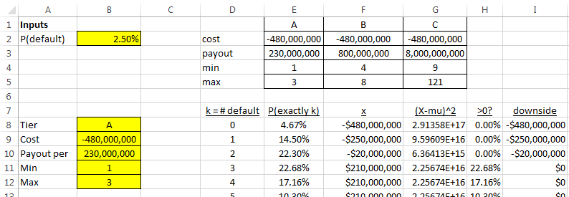
Set up spreadsheets to list each possible outcome (k=0 defaults, k=1, k=2, etc.), the probabilities for that outcome, and the associated dollars for that outcome

Slide 6
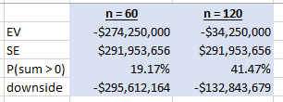
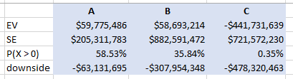
Calculations for Insure(n=60), Insure(n=120)
Calculations for Tier A, Tier B, Tier C

Slide 7
Q2. P(exactly 3 [of n=121] default if p = 2.5%)
= BINOMDIST(3,121,0.025,FALSE)
= 0.2268, or 22.68%

Slide 8
Part Two

Slide 9
Q3. What investment decision would you recommend if p = 0.025?
Q2 was designed to give you a hint, to consider combinations of investments
For example, consider S(n=121)+A+B:
If there are FEW defaults, you get money because of S(n=121)
If there are MANY payouts, you get money because of large payouts from A+B

Slide 10
Simplifying assumptions:
If selling insurance, sell n=121: with large n, incremental $4M > EV(incremental payout )
Do not invest in Tier C, since payouts only begin at default #9 … too unlikely to every pay off
Do not borrow money at 7% to invest in Treasury bonds at 2.22%
And why would investors pay you to buy T-bonds?
Also: don’t tie up money in Treasury bonds if you might need cash to pay off loans; but since liquidity wasn’t explicitly mentioned, you will not be penalized

Slide 11
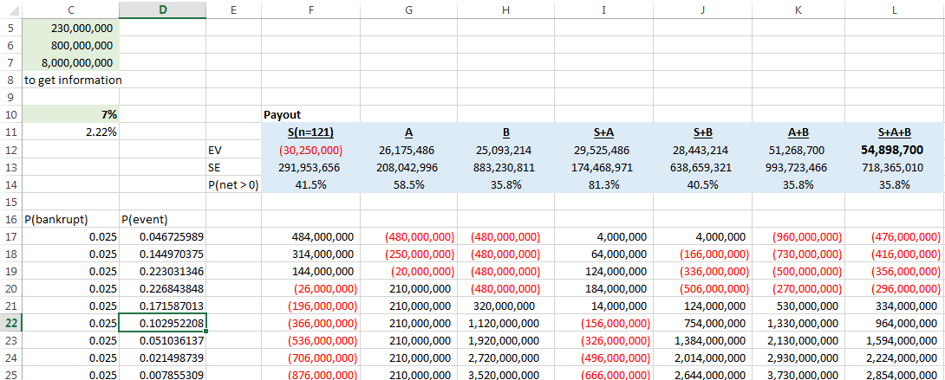
(Set up a spreadsheet to look at combinations)

Slide 12
Q3. Investment combinations
 | EV | SE | P(net > 0)
S(n=121) | -$30,250,000 | $291,953,656 | 41.5%
A | $26,175,486 | $208,042,996 | 58.5%
B | $25,093,214 | $883,230,811 | 35.8%
S+A | $29,525,486 | $174,468,971 | 81.3%
S+B | $28,443,214 | $638,659,321 | 40.5%
A+B | $51,268,700 | $993,723,466 | 35.8%
S+A+B | $54,898,700 | $718,365,010 | 35.8%

Slide 13
Aside: return on investment
Total cash required (before interest): $476.0M
Sell n=121 for $484M
Buy Tier A, Tier B for $480M each
EV of earnings before interest: $ 88.2M
Interest expense (7% of $476M): $ 33.3M
Expected net income: $54.9M
Return on $476M: 11.5%
Better than 2.2% … this is why people would pay you!

Slide 14
Q4/Q5. Pay $80M for information? If so, how to invest?
To find the value of information, first calculate the expected value is with no information about p, then calculate the expected value with information about p

Slide 15
If no information is available, then best guess for probability of k defaults is
P(k defaults) = (0.4)*P(k defaults if p = 0.025)
+ (0.3)*P(k defaults if p = 0.015)
+ (0.3)*P(k defaults if p = 0.035)
Compute exp. value with correct p’s:
S(n=121) | A | B | S+A
-$30,250,000 | $3,811,529 | $95,004,290 | $7,161,529
S+B | A+B | S+A+B
$98,354,290 | $98,815,818 | $102,445,818

Slide 16
If information is available, best strategy varies (and leads to an increase in expected value, from $102.4M to $308.6M)
 | If p=0.025 | If p=0.035 | If p=0.015 | Wtd average
S(n=121) | -$30,250,000 | -$235,950,000 | $175,450,000 | -$30,250,000
A | $26,175,486 | $110,562,517 | -$132,758,069 | $3,811,529
B | $25,093,214 | $669,582,812 | -$386,359,464 | $95,004,290
S+A | $29,525,486 | -$91,787,483 | $76,291,931 | $7,161,529
S+B | $28,443,214 | $467,232,812 | -$177,309,464 | $98,354,290
A+B | $51,268,700 | $780,145,328 | -$519,117,533 | $98,815,818
S+A+B | $54,898,700 | $578,075,328 | -$309,787,533 | $102,445,818
Best | $54,898,700 | $780,145,328 | $175,450,000 | $308,638,078

Slide 17
Q4. Info is worth $308M – $102M = $206M
 | If p=0.025 | If p=0.035 | If p=0.015 | Wtd average
S(n=121) | -$30,250,000 | -$235,950,000 | $175,450,000 | -$30,250,000
A | $26,175,486 | $110,562,517 | -$132,758,069 | $3,811,529
B | $25,093,214 | $669,582,812 | -$386,359,464 | $95,004,290
S+A | $29,525,486 | -$91,787,483 | $76,291,931 | $7,161,529
S+B | $28,443,214 | $467,232,812 | -$177,309,464 | $98,354,290
A+B | $51,268,700 | $780,145,328 | -$519,117,533 | $98,815,818
S+A+B | $54,898,700 | $578,075,328 | -$309,787,533 | $102,445,818
Best | $54,898,700 | $780,145,328 | $175,450,000 | $308,638,078

Slide 18
Q4. Info is worth $308M – $102M = $206M
Q5. Optimal strategy for p=0.025/0.015/0.035 is S+A+B / A+B / S, with EV (after accounting for $80M for cost of information) = $228.6M
 | If p=0.025 | If p=0.035 | If p=0.015 | Wtd average
S(n=121) | -$30,250,000 | -$235,950,000 | $175,450,000 | -$30,250,000
A | $26,175,486 | $110,562,517 | -$132,758,069 | $3,811,529
B | $25,093,214 | $669,582,812 | -$386,359,464 | $95,004,290
S+A | $29,525,486 | -$91,787,483 | $76,291,931 | $7,161,529
S+B | $28,443,214 | $467,232,812 | -$177,309,464 | $98,354,290
A+B | $51,268,700 | $780,145,328 | -$519,117,533 | $98,815,818
S+A+B | $54,898,700 | $578,075,328 | -$309,787,533 | $102,445,818
Best | $54,898,700 | $780,145,328 | $175,450,000 | $308,638,078

Slide 19
Part Three

Slide 20
Q6. If information is imperfect, we need to calculate probabilities based on incorrect information
P(think that p = 0.025) =
P(p is actually 0.025)*P(think p = 0.025)
+ P(p is actually 0.015)*P(think p = 0.025)
+ P(p is actually 0.035)*P(think p = 0.025)
= (0.4)(0.8) + (0.3)(0.1) + (0.3)(0.1) = 0.38
Likewise, P(think that p = 0.15) = 0.31

Slide 21
A tree diagram can help illustrate probabilities:
P(think p=0.025) = 0.03 + 0.32 + 0.03 = 0.38
P(p=0.025 | think p=0.025) = 0.32 / 0.38 = 0.8421
p = 0.015
Think p = 0.015
0.9
0.1
Think p = 0.025
0.3
Think p = 0.015
p = ?
p = 0.025
0.1
0.4
0.8
Think p = 0.025
0.1
0.3
Think p = 0.035
p = 0.035
0.1
Think p = 0.025
0.9
Think p = 0.035

Slide 22
With 100% correct information, EV = (0.4)(54.9M) + (0.3)(175.5M) + (0.3)(780.1M) – 80M = $228.6M
With imperfect information, EV = (0.38)(67.4M) + (0.31)(148.9M) + (0.31)(686.1M) – 80M = $204.5M
Net decrease in value = $24,170,374

Slide 23
Q7. What if risks are unequal?
24 “energy sector” with p = 0.0860
97 “non-energy” with p = 0.0099
P(exactly 3 defaults) =
P(0 energy and 3 non-energy)
+ P(1 energy and 2 non-energy)
+ P(2 energy and 1 non-energy)
+ P(3 energy and 0 non-energy)

Slide 24
P(exactly 3)
= P(0E, 3N) + P(1E, 2N) + P(2E, 1N) + P(3E, 0N)
= BINOMDIST(0,24,0.086,FALSE) *BINOMDIST(3,97,0.0099,FALSE)
+ BINOMDIST(1,24,0.086,FALSE) *BINOMDIST(2,97,0.0099,FALSE)
+ BINOMDIST(2,24,0.086,FALSE) *BINOMDIST(1,97,0.0099,FALSE)
+ BINOMDIST(3,24,0.086,FALSE) *BINOMDIST(0,97,0.0099,FALSE)
= 0.2313

Slide 25
Any questions?

Slide 26
Concluding thoughts

Slide 27
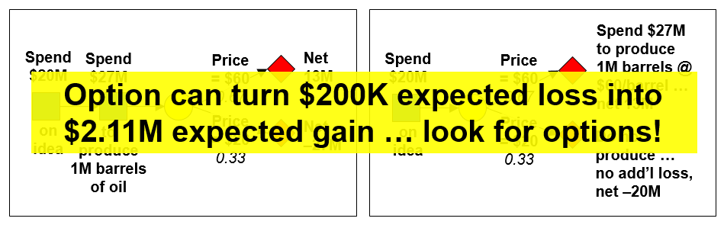
GSBA 545 lessons
Reminder from Project 1: lesson for GSBA 545, Data-based Decision Making:
Use data to make decisions!
Make the most of all information (including information on variability)
From Lecture 3: look for possible options!

Slide 28
Closing thoughts
Making decisions in the business world is difficult … do your best
Three big lessons from GSBA 545:
Lesson #1: if a deal seems too good to be true, maybe it is … be careful
Lesson #2: there ARE opportunities to make money … be smart, look for options
Lesson #3: ( … saved for later …)

